Slide 1
Defending with the Graph of Graphs
John Lambert
Security Fellow
Corporate Vice President

Slide 2


Why Graph?

Slide 3

Understanding Microsoft's threat intelligence landscape
78
300
Tracked signals from:
Nation state actors
Ransomware groups
Private sector offensive actors (PSOA)
Dev groups (DEV)
trillion signals each day
tracked groups
Majority of tracked activity related to…
Typhoon
Sandstorm
Sleet
Blizzard
China
Iran
North Korea
Russia
Tempest
Flood
Storm
Tsunami
Financially motivated
Influence operations
DEV
PSOA

Slide 4
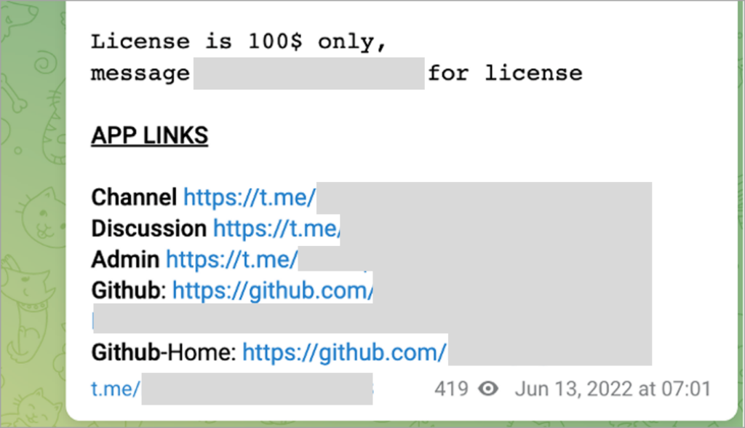
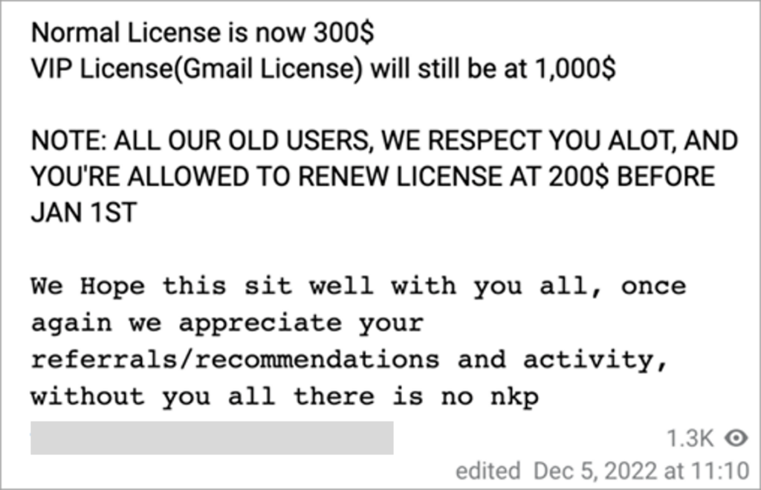






Storm 1101 Adversary-in-the-Middle Phish Kit
1
2
xxxxxxx
xxxxxxx
4
3
5
6
7

Slide 5
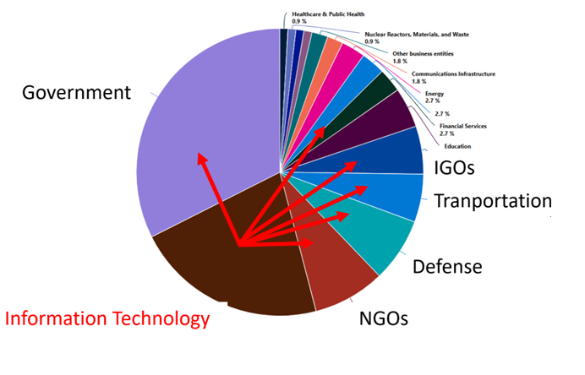

Midnight Blizzard thinks deeply about chains of trust, transitive access, and hack-one to hack-many
Software Supply chain
Saas Provider
SolarWinds
Email Security
customers
Cloud Solution Providers
Identity Providers
Customer Support
3P provider
End Customer

Slide 6




Midnight Blizzard Application Abuse
Corp
Midnight Blizzard
User
App
Service Principal
Legacy Tenant
Elevated Roles

Slide 7


Volt Typhoon - Targeting Critical Infrastructure
Resource development, Initial access
Execution
Persistence
Exploitation and command and control
Credential access, lateral movement
Action on objectives
Compromised SOHO devices
Network edge device exploits
WMIC, PowerShell, and CLI
Valid accounts
Internal proxy
Virtualization evasion
Remote system discovery
LSASS process memory dumping
Local browser data
Domain controller access
Intelligence gathering
Extended persistence
CVE
Internal Network
Volt Typhoon
VPN appliance
User Credentials

Slide 8
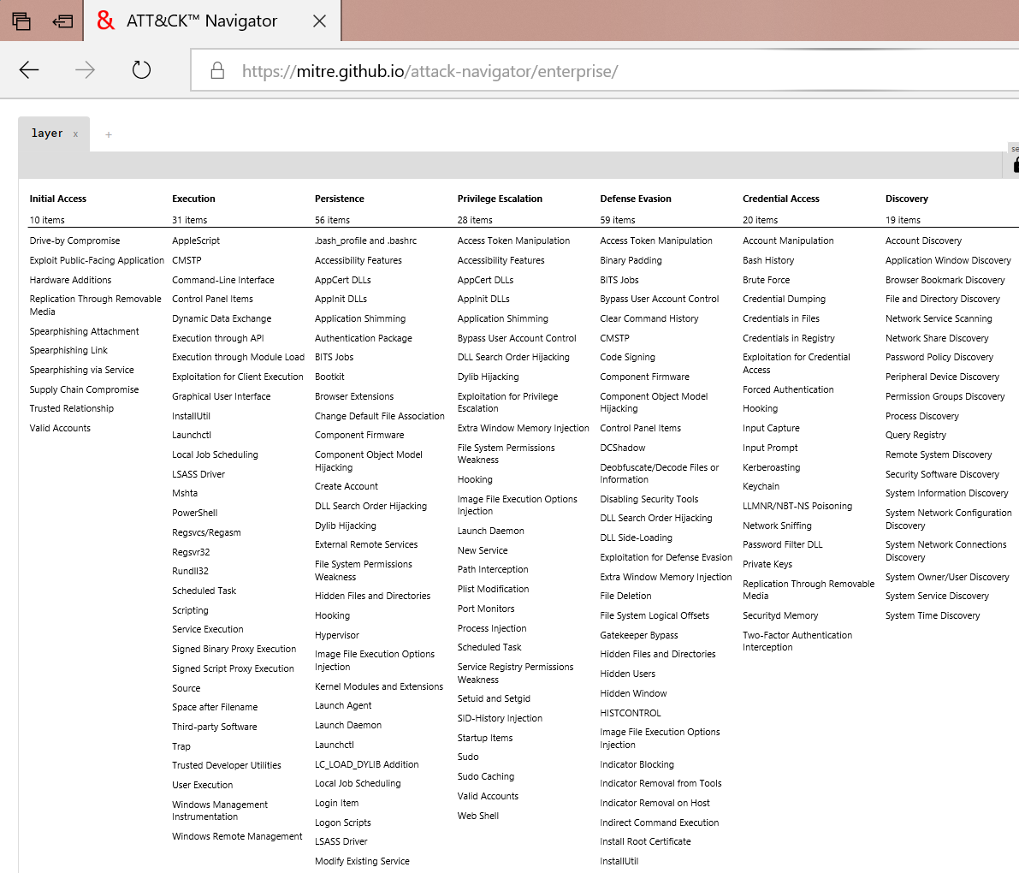
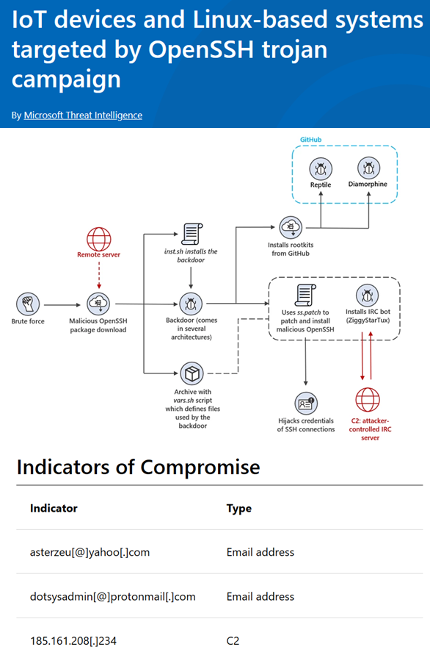
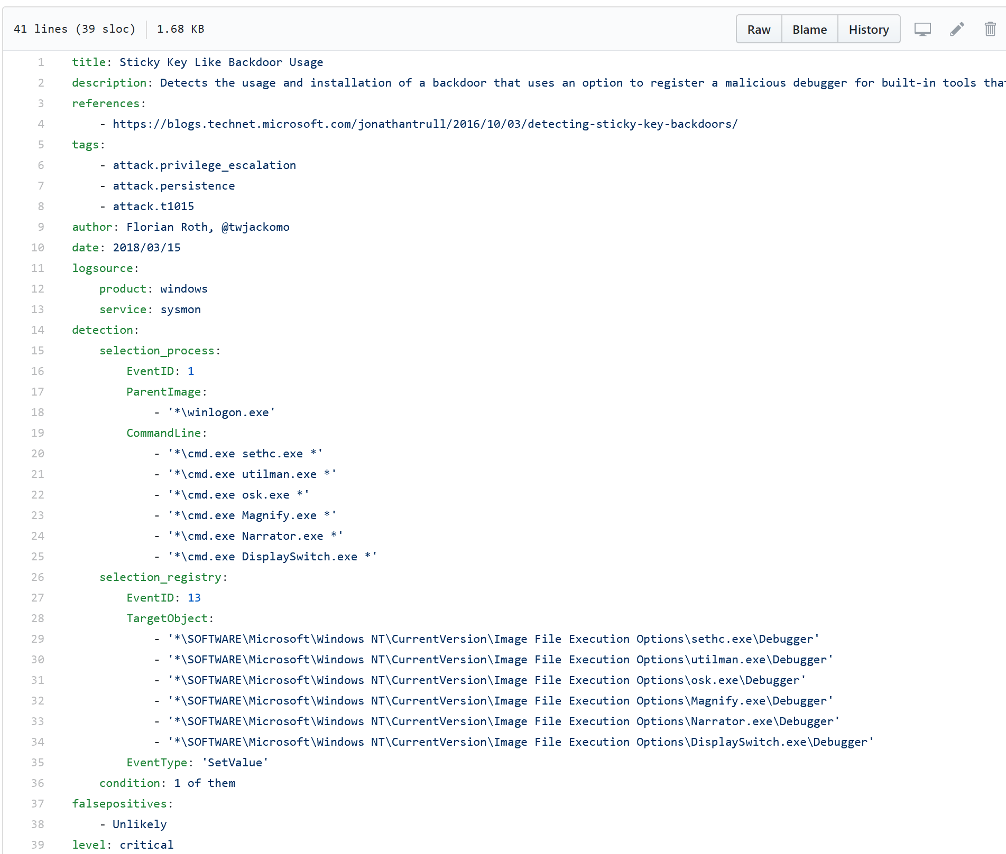
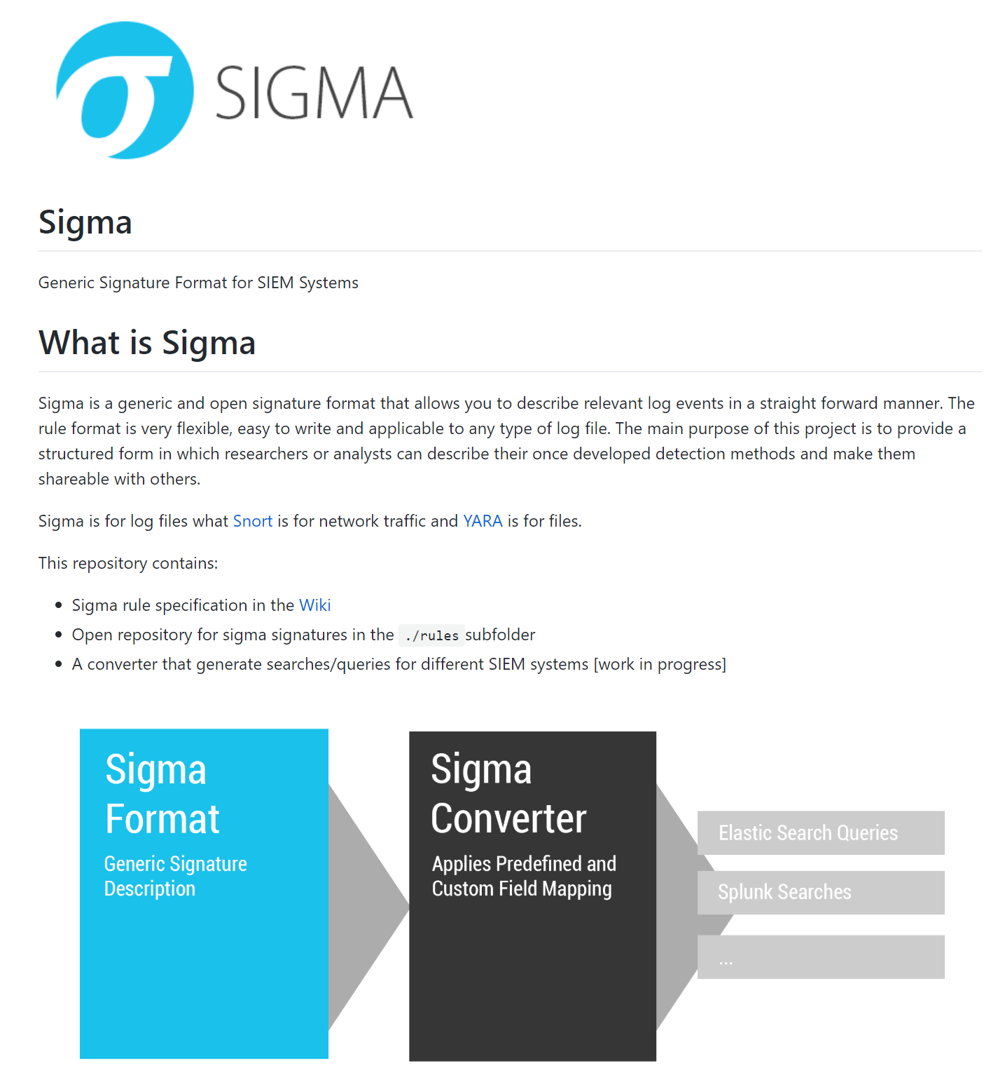
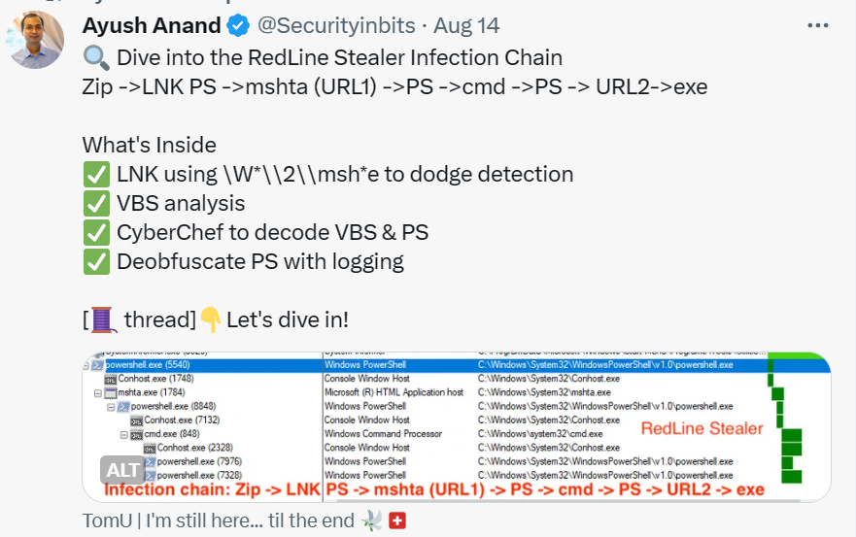
Threat Hunting
MITRE ATT&CK
Blogs
Sigma and Yara rules
Tweets

Slide 9
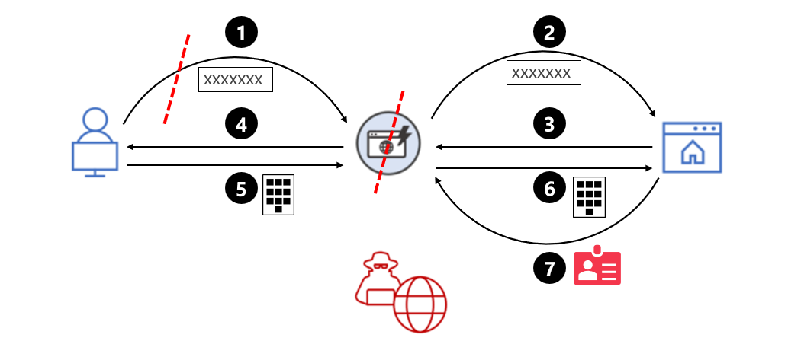
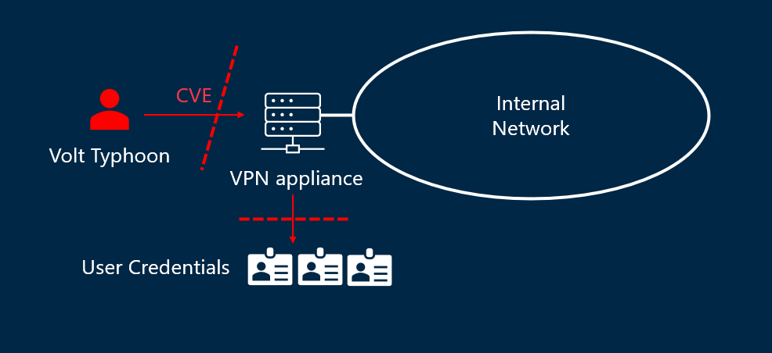
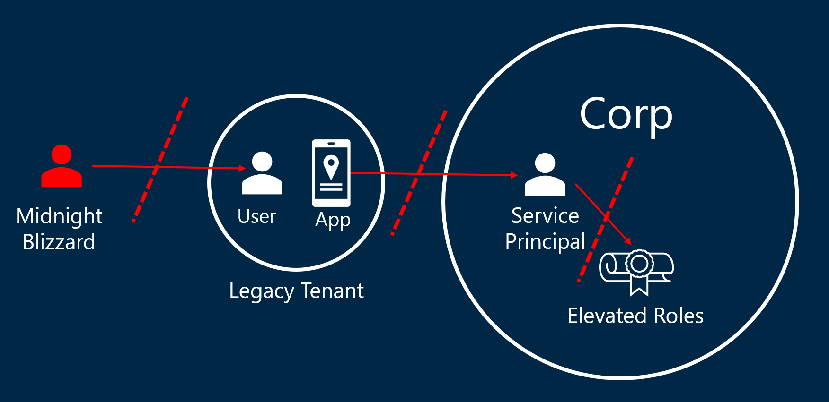
Model as Attack Graphs
Cloud Solution Providers

Slide 10
Attack and Defense as Graph Operations
Attack
Defend
Harden
AiTM Phishing
Reset user credentials
Deploy Phish-resistant MFA
Compromise User node
Break attacker edge
Prevent attacker edges
Compromise Application Secret
Reset app secret
Create per-customer keys
Compromise App node
Break attacker edge
Minimize edge fan out
Use Network Appliance CVE
Reinstall device
Robust Patch Management
Compromise Device node
Break attacker edge
Decrease edge availability
Lateral movement via psexec
Reset credentials
Use Privilege Admin Workstations
Compromise Device node
Break attacker edge
Separate user + admin graph

Slide 11
Building the Graph

Slide 12
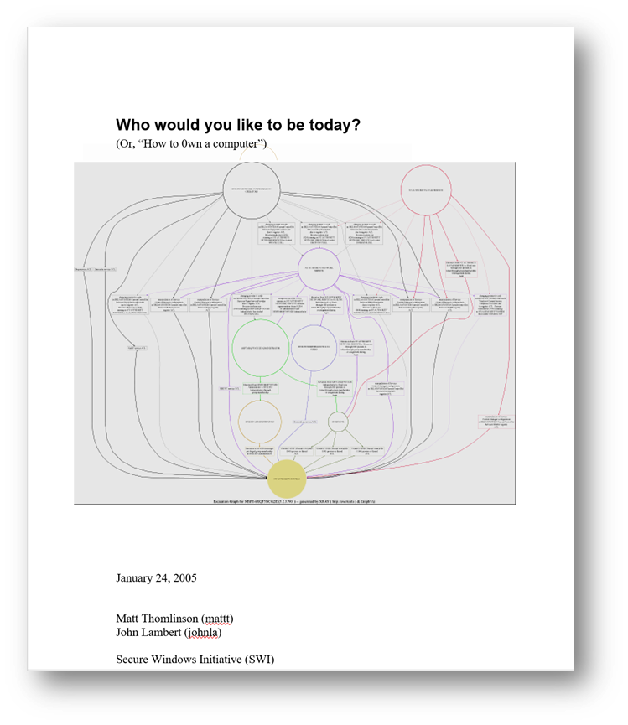
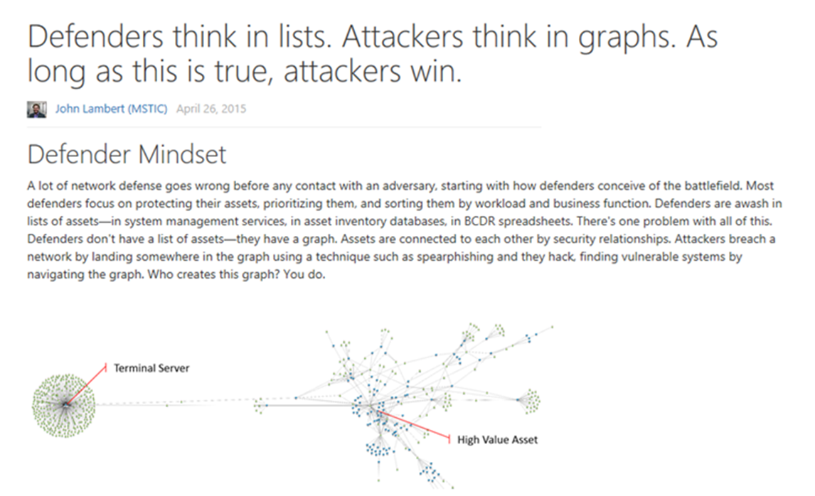
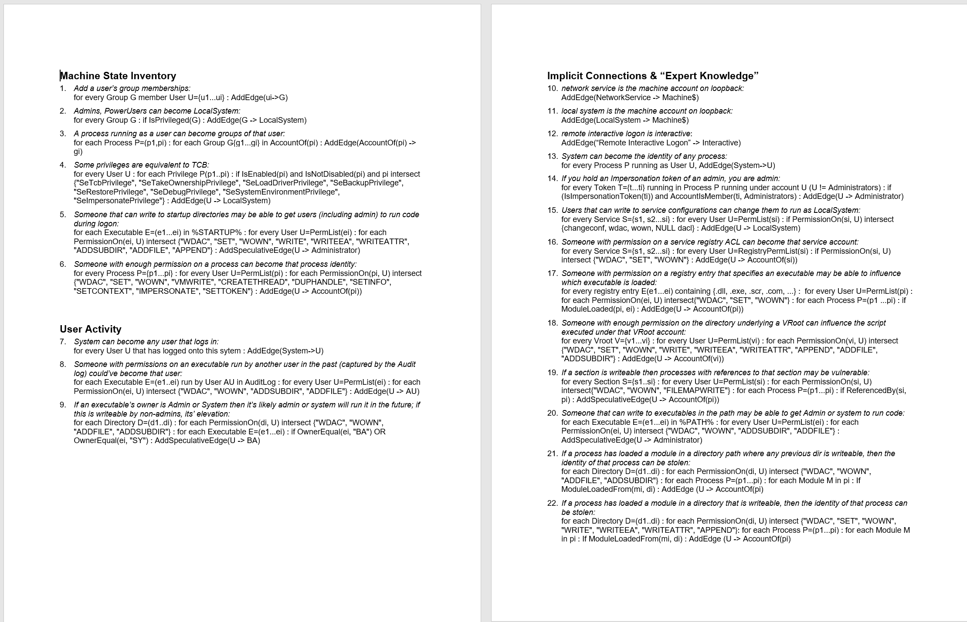
Thinking about graphs...

Slide 13
Midnight Blizzard Application Abuse
Asset
Activity
Corp
Midnight Blizzard
User
App
Service Principal
Legacy Tenant
Elevated Roles
Attack Paths

Slide 14
Graphs Abound…but how to build an Attack Graph? All data is security data, it just depends on the crisis
Assets
Activity
Attack Paths

Slide 15

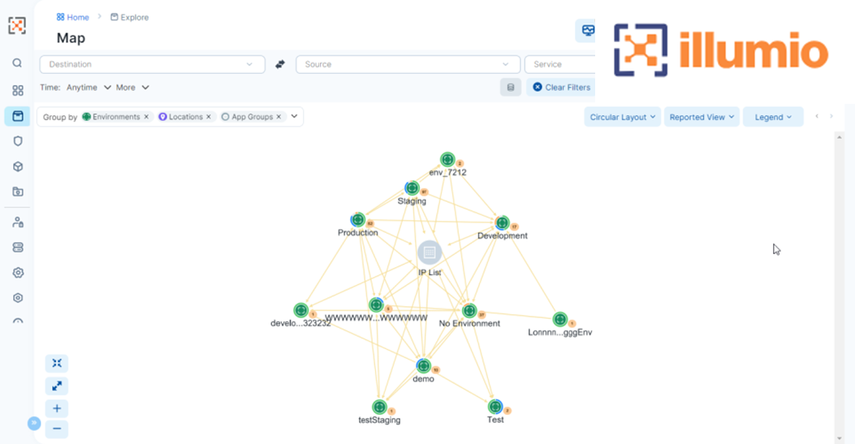
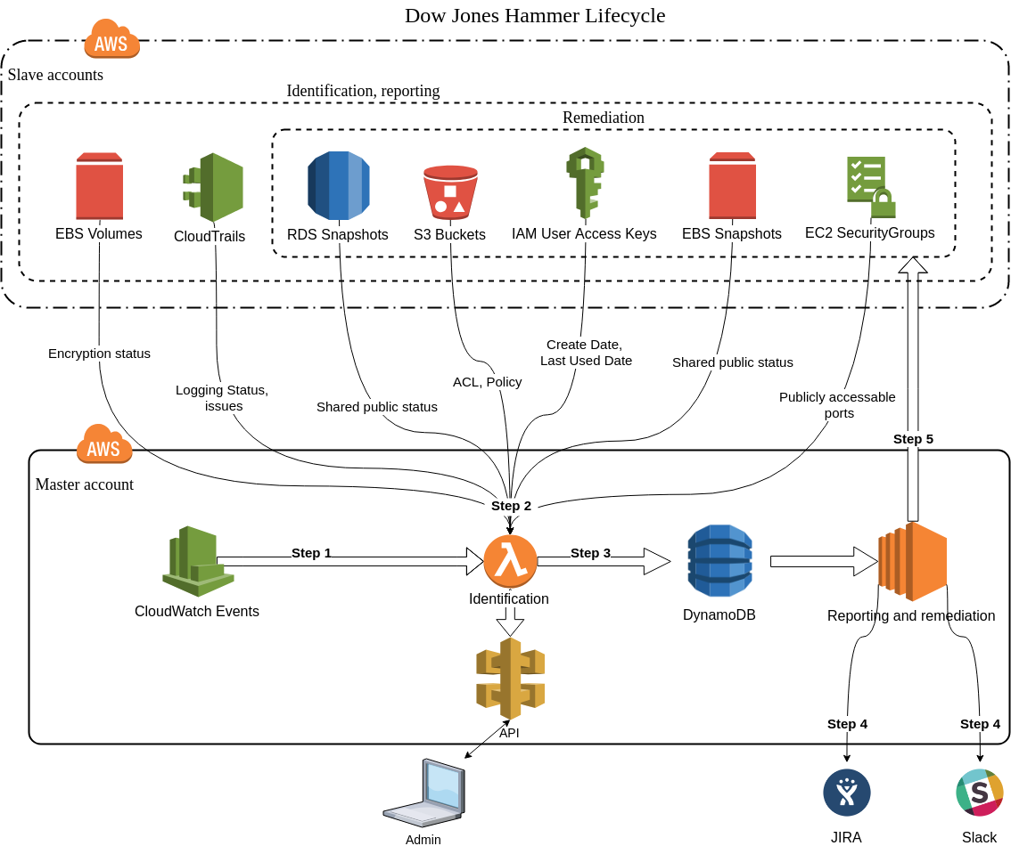
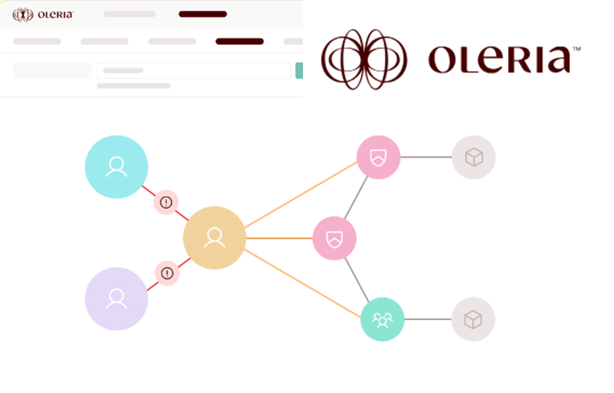
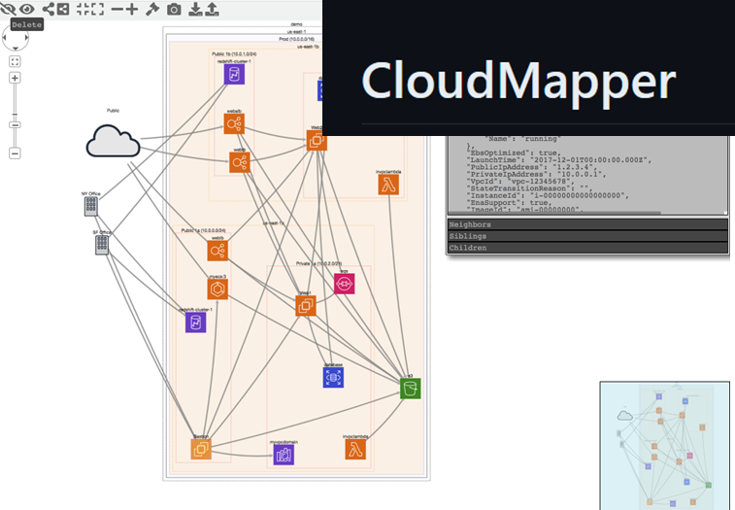
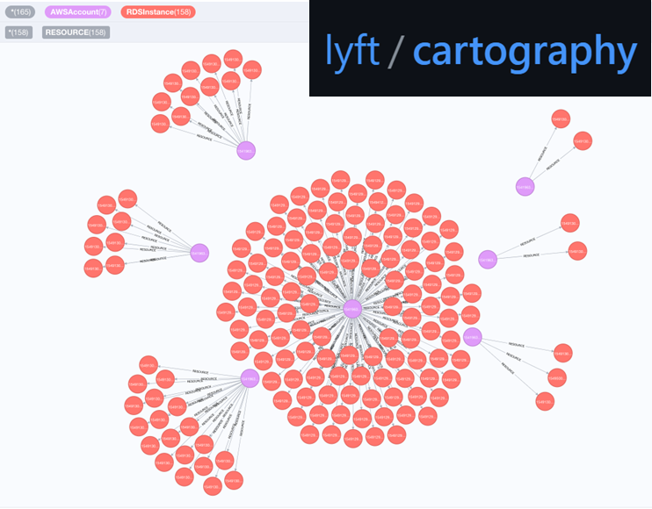
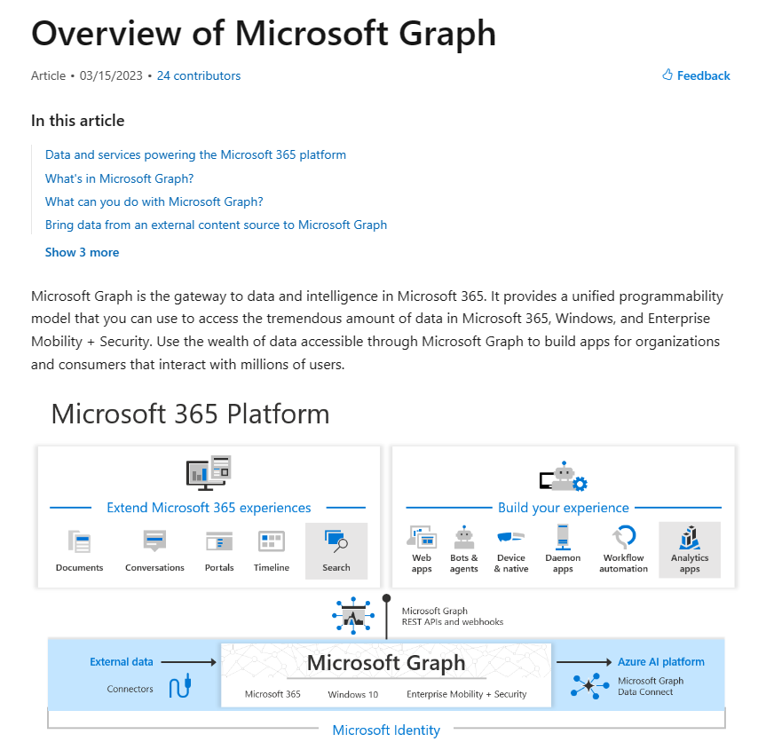
Asset graphs for infrastructure, network, and access control

Slide 16
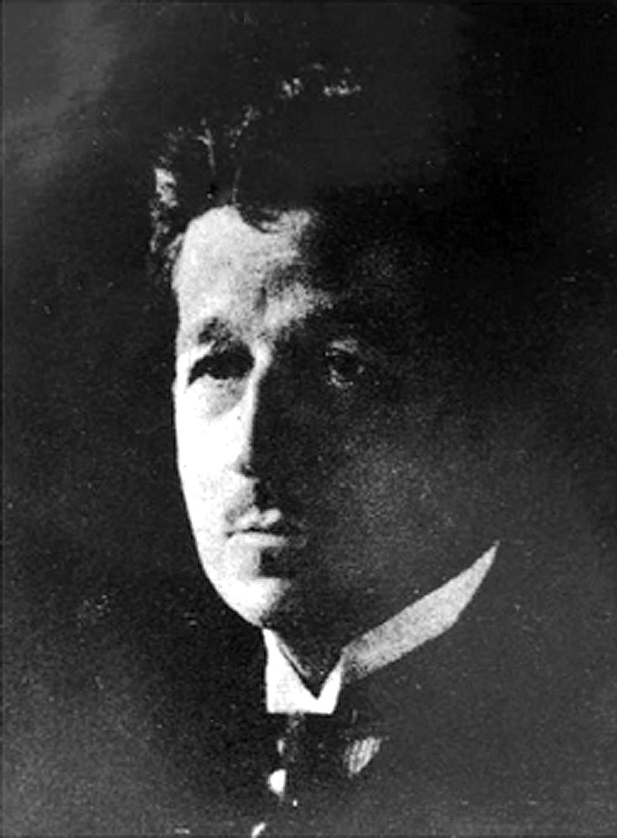
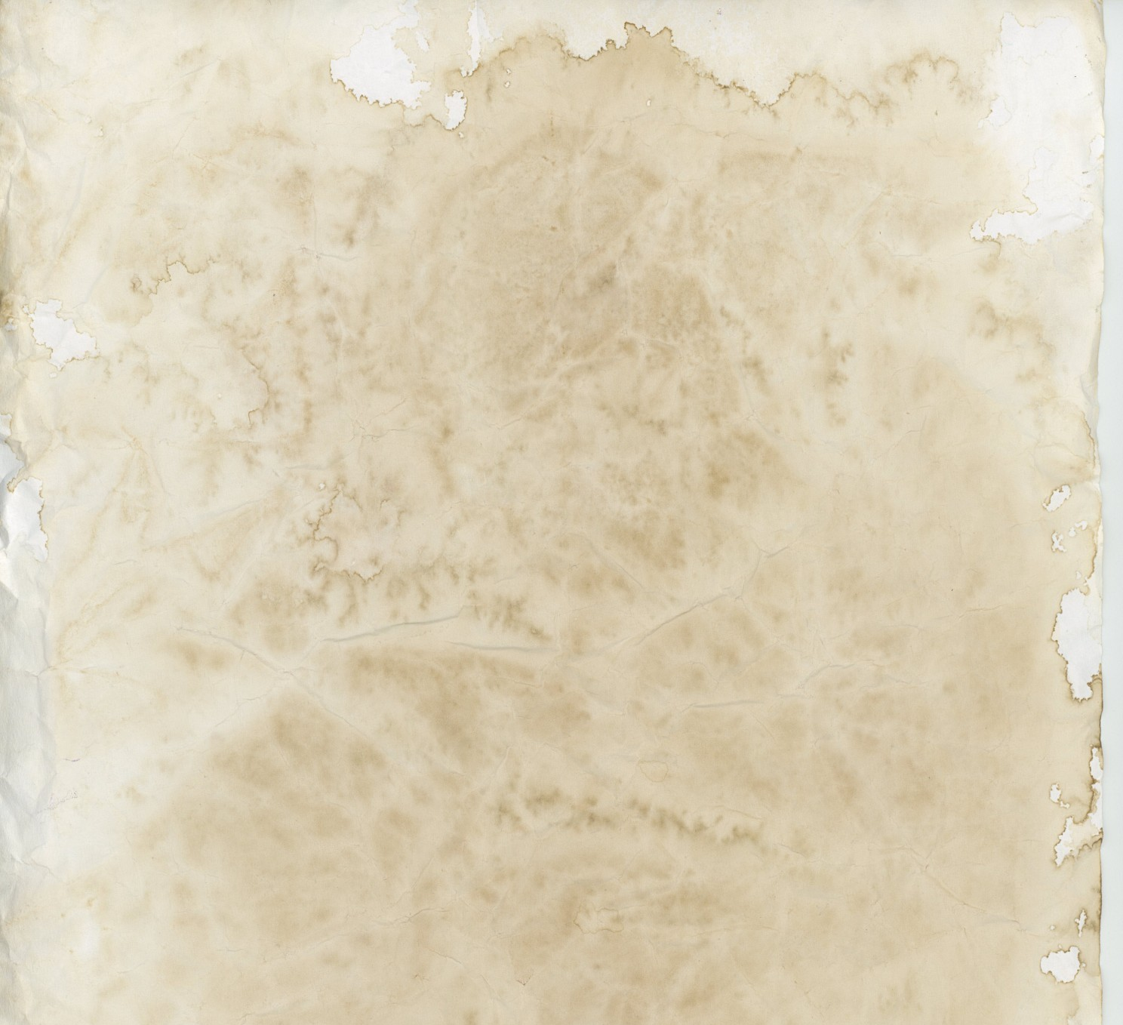
Activity Logs
Also known as Locard's exchange principle
“Wherever he steps, whatever he touches, whatever he leaves, even unconsciously, will serve as a silent witness against him…
This is evidence that does not forget. It is not confused by the excitement of the moment. It is not absent because human witnesses are. It is factual evidence.”
Dr. Edmond Locard (1877–1966)
French criminologist and pioneer in forensic science

Slide 17
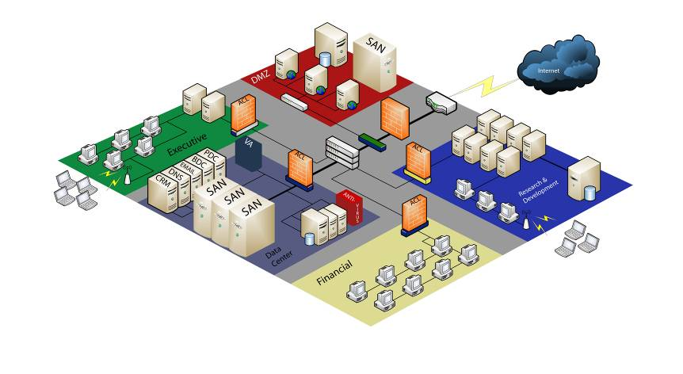
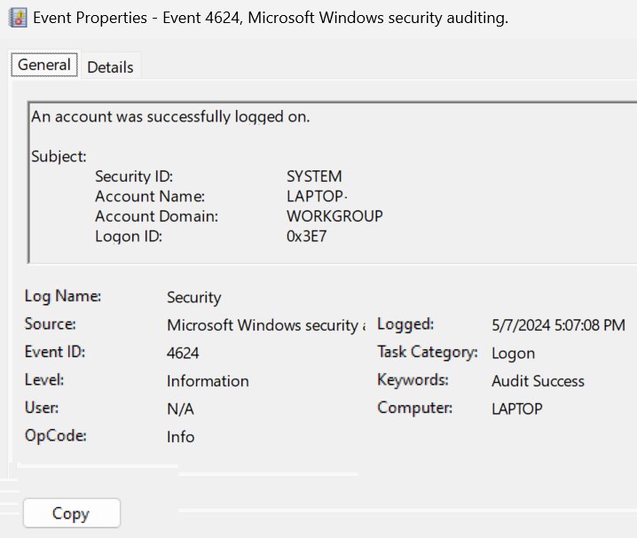
Every contact leaves a trace…in an activity log
1
Certificate Authority Logs
To protect this critical data…
2
…we need all these logs
Logon Session
Host scanning results
Critical business data
VPN Logs
Firewall Logs
Vulnerability Assessment results
Web Proxy Logs
Event log data
Wireless logs
Network IDS results
Netflow
Crash reports
Security Scan results
Window Domain Logins
DHCP Logs
Anti-virus Logs
Remote Access Logs
Account / Group Membership Logs

Slide 18
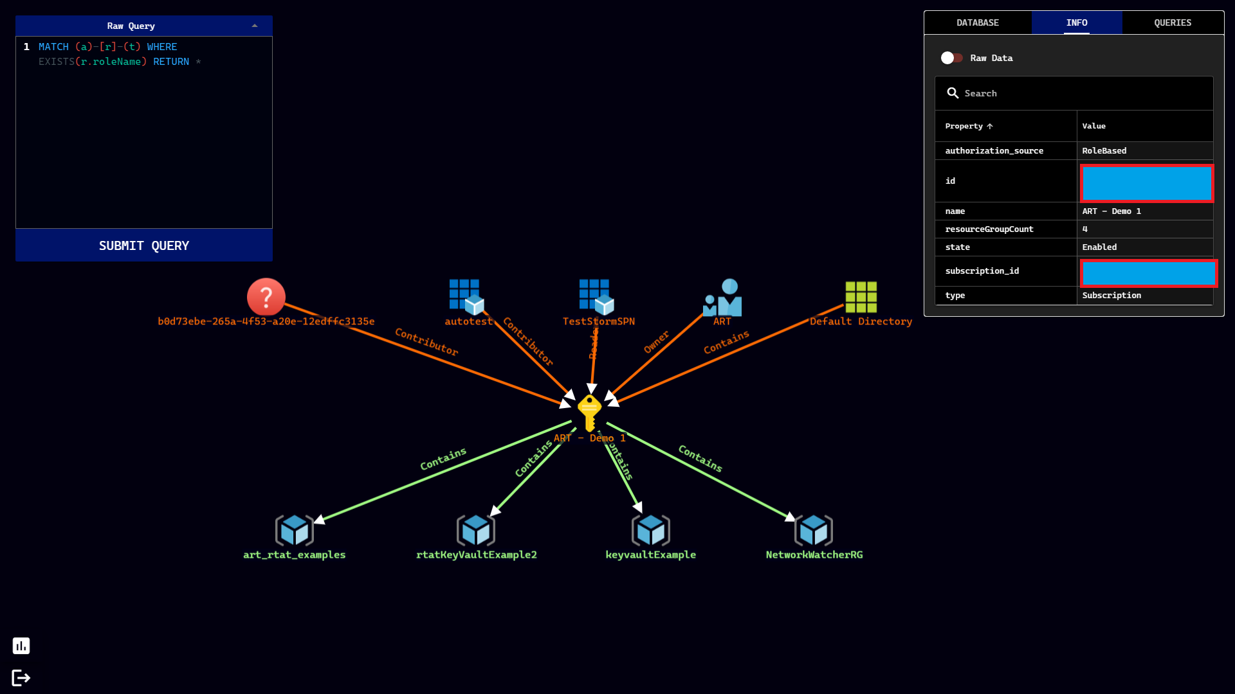
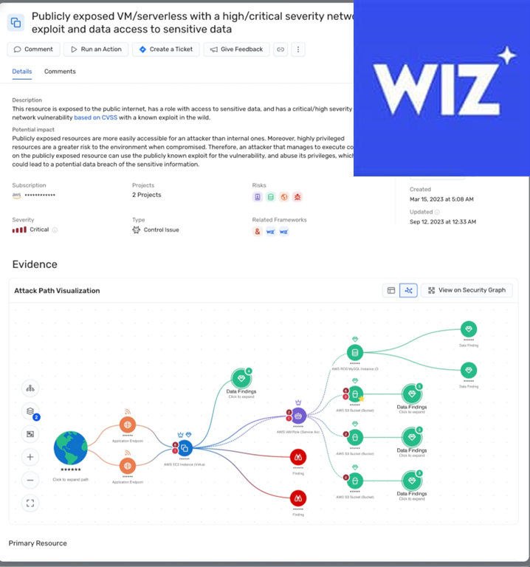

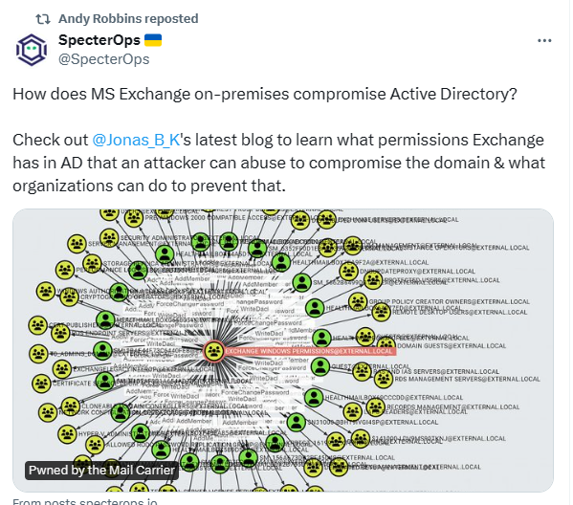
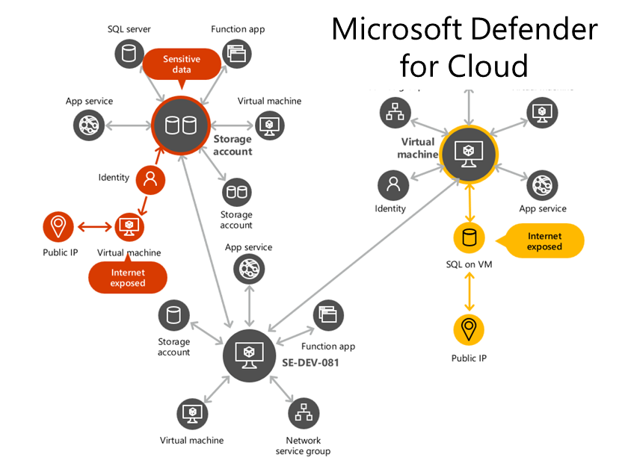

Many security products and tools expose Attack Paths

Slide 19
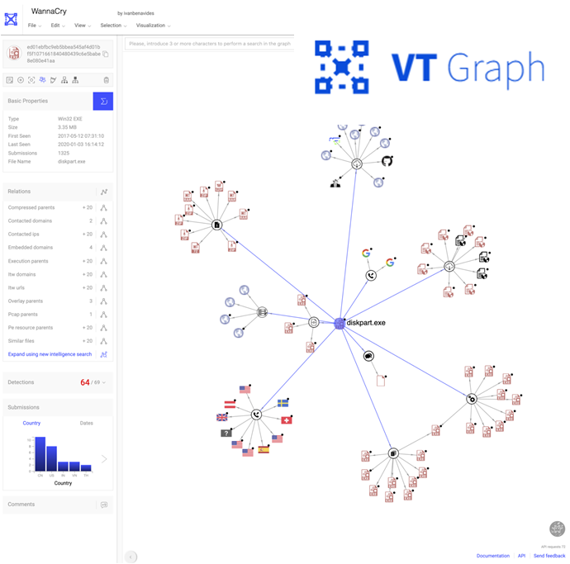
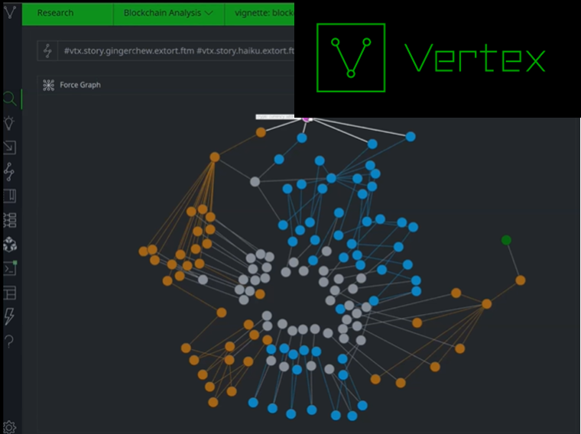
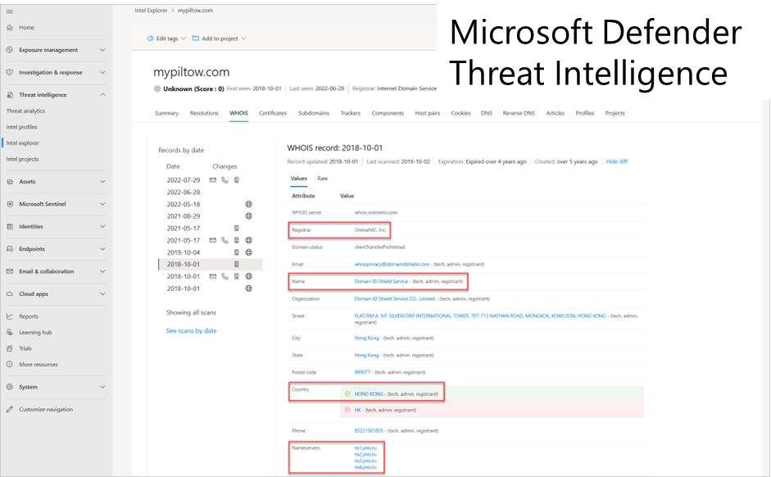
Threat Intelligence related graphs

Slide 20
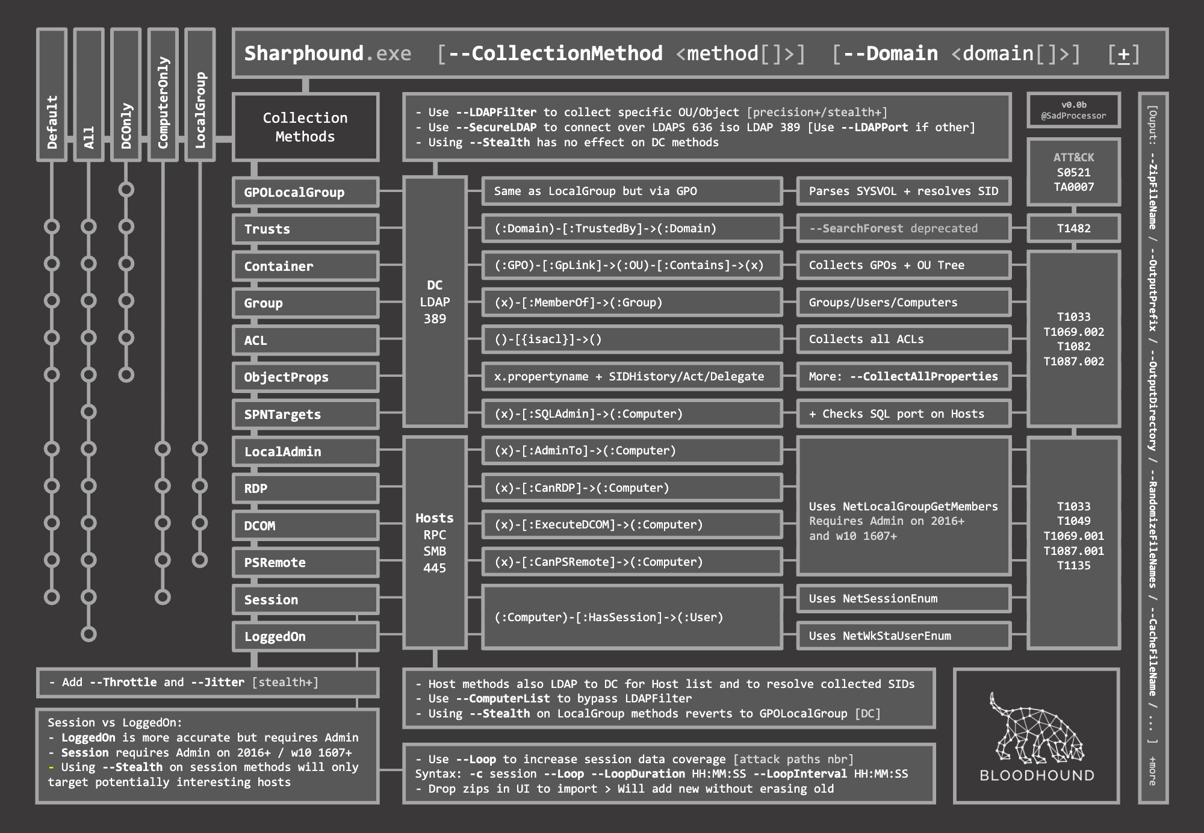
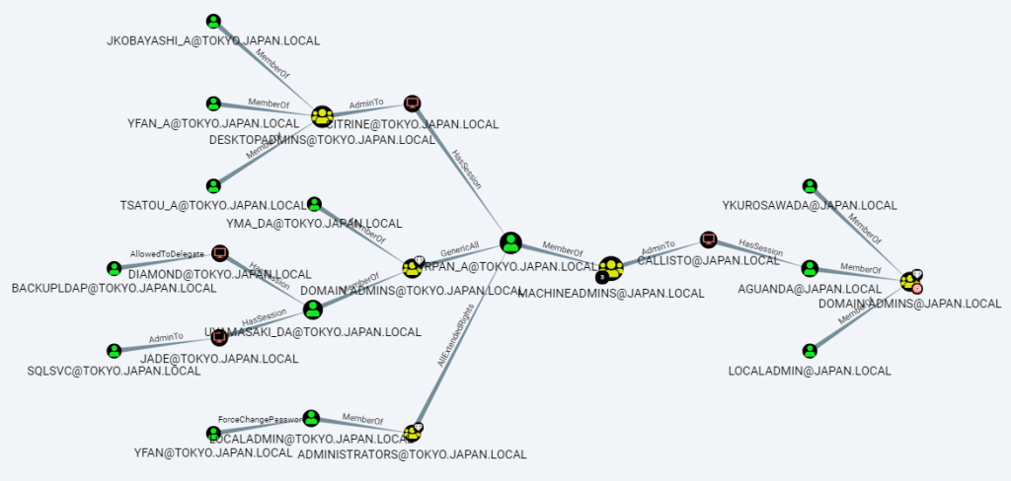
Example Bloodhound queries
Member of group
Assets
Activity
Attack Paths
MATCH (n:User),
(m:Group
{name: "DOMAIN ADMINS@DOMAIN.LOCAL"}),
p=shortestPath((n)-[*1..]->(m))
RETURN p
Admin logged in with Active session
Member of group
cypherhound/customqueries.json at main · fin3ss3g0d/cypherhound · GitHub

Slide 21
Asset Inventory
BloodHoundAD / AzureHound
Microsoft Internal Attack Graph
app_role_assignments
apps
automation_accounts
client
container_registries
devices
directory_objects
function_apps
groups
keyvaults
logic_apps
managed_clusters
management_groups
resource_groups
role_assignments
roles
service_principals
storage_accounts
subscriptions
tenants
users
virtual_machines
vm_scale_sets
web_apps
Asset Type | Count
Resources | 25
Networking | 10
Infrastructure | 10
Engineering Systems | 20
Policy | 15
Identity | 20
Vulnerability | 5
400M nodes
100 types
1B edges
200 types
6B
properties
See AzureHound/client at main · BloodHoundAD/AzureHound · GitHub

Slide 22
To defend you need the graph of graphs
Assets
Entitlements
Network
Threats
Vulnerabilities and Risk

Slide 23
Collaborating through the Graph

Slide 24
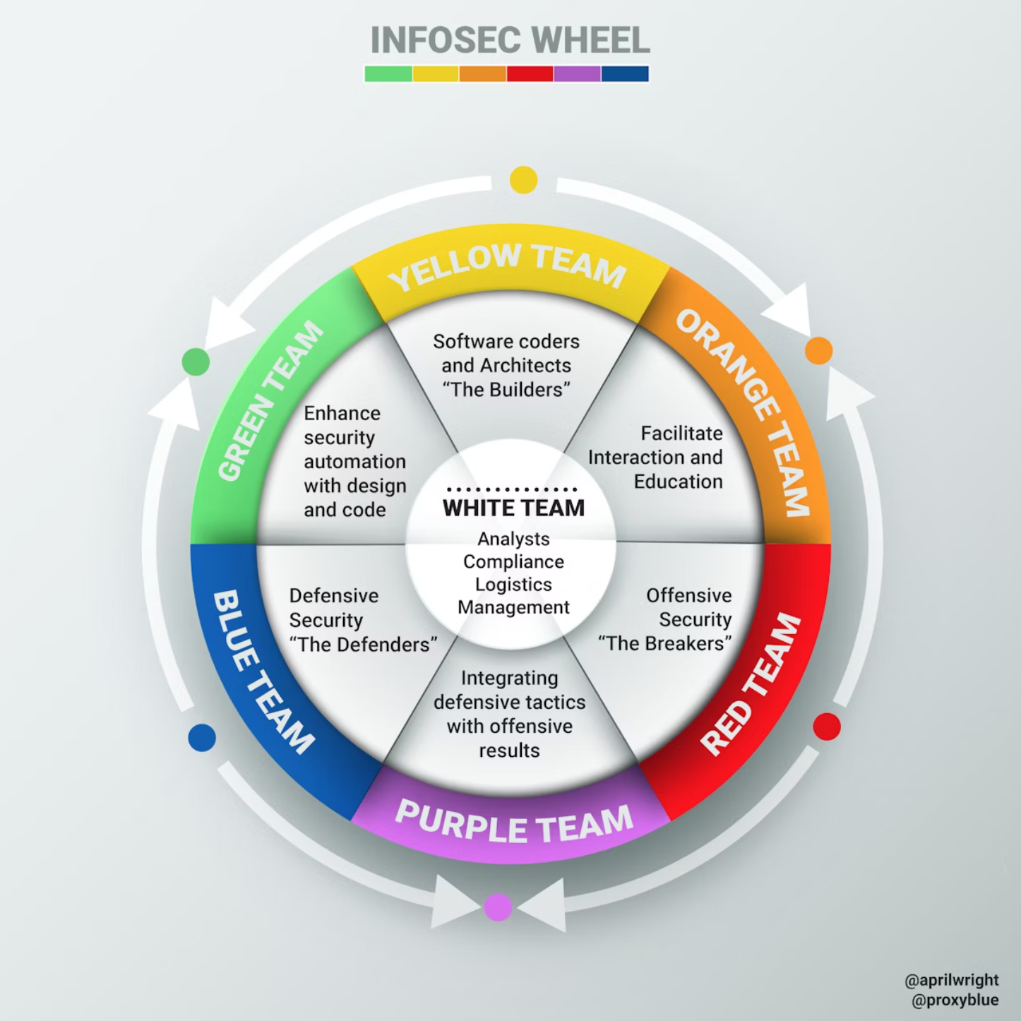
Collaboration across disciplines Provide context, Prioritize effort, Automate
Design to minimize and harden edge traversal
Onboard data sources to populate the graph
Drive constant “get green; stay green” improvements
Use in IR to scope investigation and remediation
Educate on attack graph mindset
Model tradecraft in attack paths
Identify gaps and improve modeling
Brainstorm new node and edge traversals and mitigations
@aprilwright
@proxyblue

Slide 25
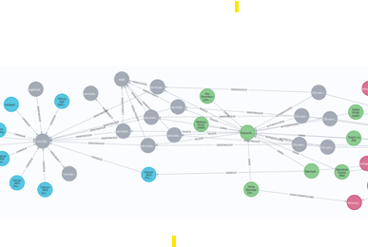
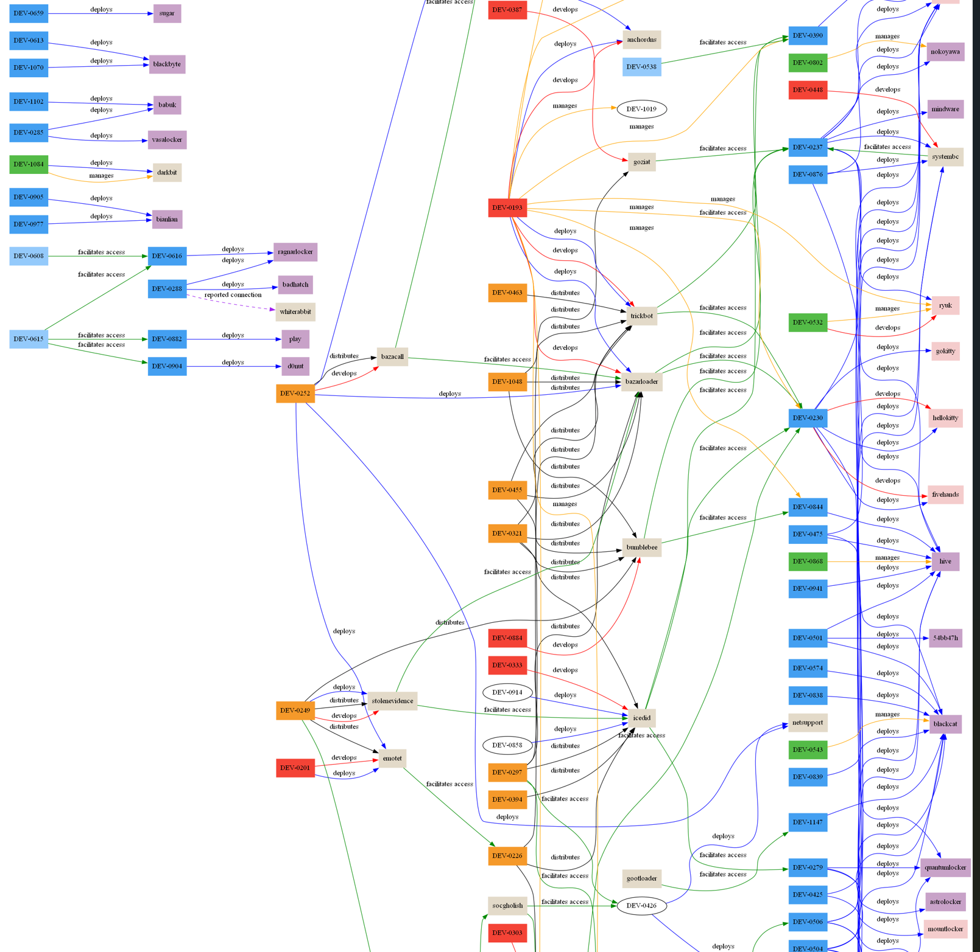
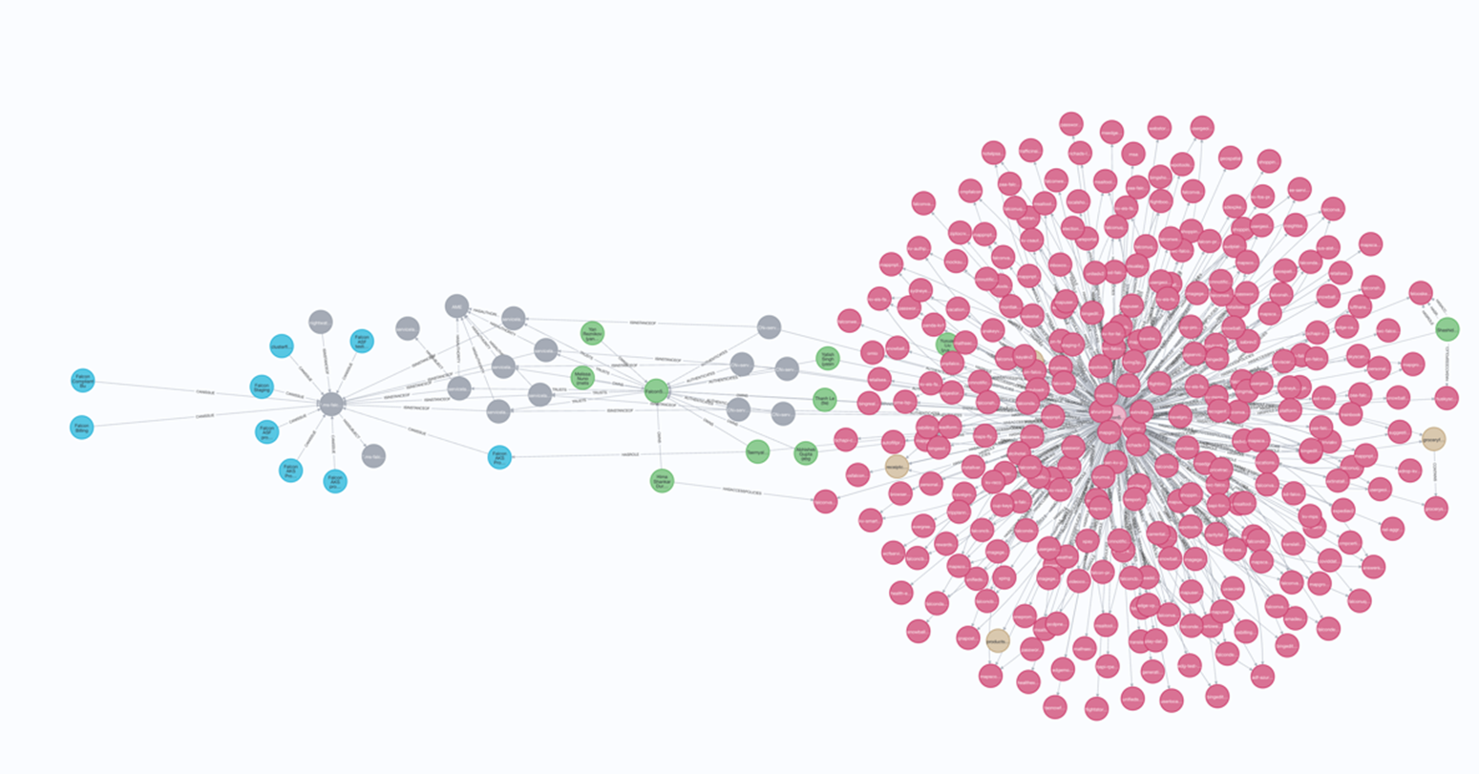
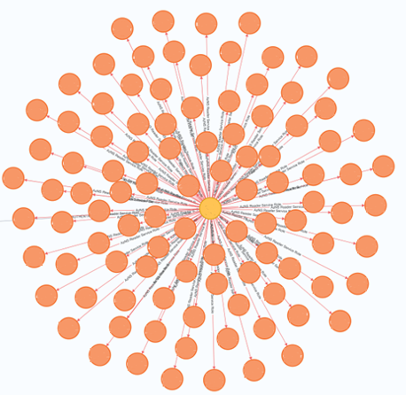
Layers in the Graph: Different projections for different use cases
Theat Intel Graph
Known Attacker TTP Paths
Incident Graph
Actual Paths Observed
Attack Graph
Theoretical Paths Possible
Security Graph
Asset Configuration & Topology

Slide 26
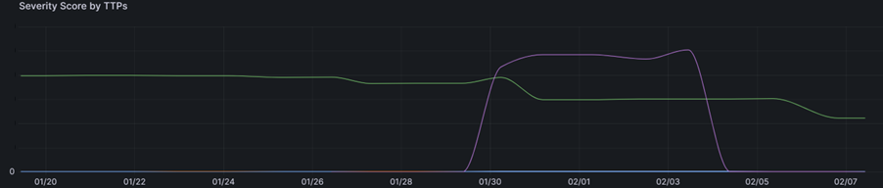
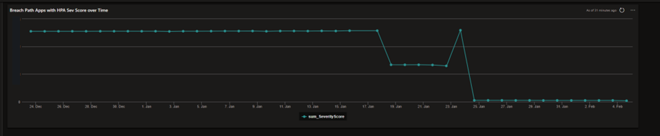
Visualizing Remediation
All risk eliminated
Import data and discover new risks
Ongoing remediation
Remediate over privilege to reduce risk

Slide 27
Innovating with the Graph

Slide 28
Generative AI Applications
Generate Graph Queries
Who are the Email administrators?
MATCH p1=()-[:AUTHENTICATES]-(source)-[:HASROLE]-(n:AADROLE) where n.tenantid="<…>" and n.displayname= "Exchange Administrator" RETURN p1 LIMIT 100
Use in Retrieval Augmented Generation (RAG)
Enhance base model performance with information and context to help answer the question
Predict attacks
“Where might an attacker go next after compromising X?”

Slide 29
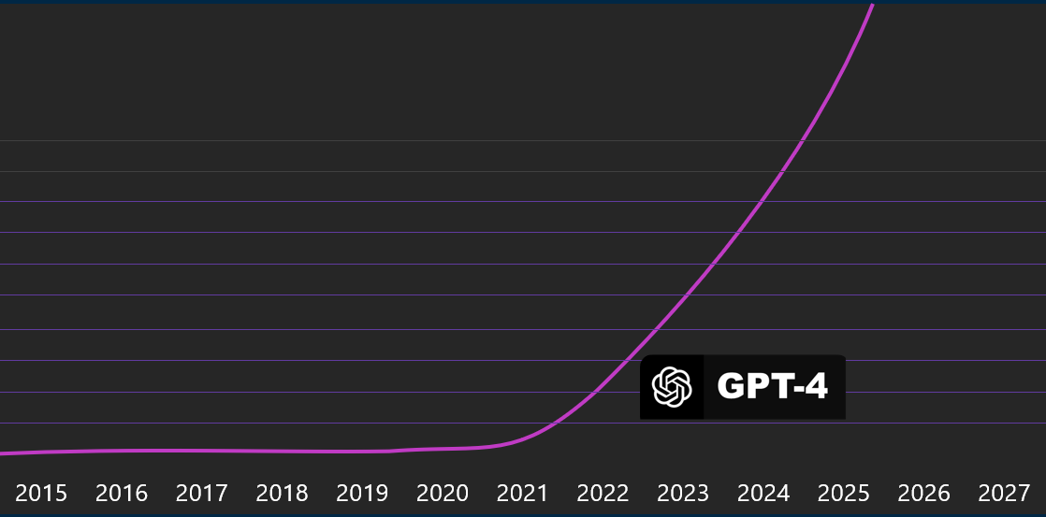
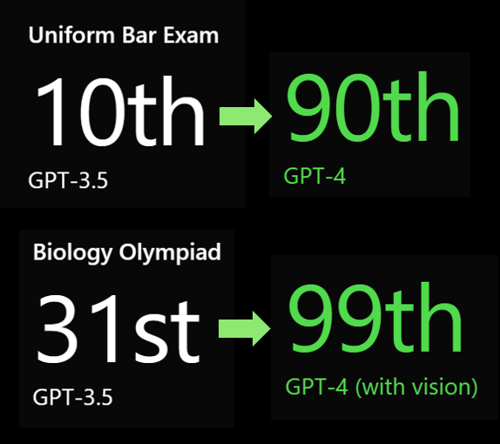
Generative AI Applications
Evidence
Context
Reasoning
Judgment
Alerts
Hunt results
Anomalies
IP, user, endpoint
Relations,
Aggregates
Logic, Security expertise
Incrimination or exoneration

Slide 30
Thank you!

Slide 31
Links
Getting Started
https://github.com/BloodHoundAD/BloodHound
https://github.com/dowjones/hammer
https://github.com/BloodHoundAD/BloodHound
GitHub - lyft/cartography: Cartography is a Python tool that consolidates infrastructure assets and the relationships between them in an intuitive graph view powered by a Neo4j database.
GitHub - Azure/Stormspotter: Azure Red Team tool for graphing Azure and Azure Active Directory objects
Introducing the InfoSec colour wheel — blending developers with red and blue security teams. | HackerNoon
No longer maintained but listed for reference and inspiration
https://github.com/duo-labs/cloudmapper
https://github.com/vysecurity/ANGRYPUPPY
https://github.com/Netflix/security_monkey

